Slide 1
Tomasz Kielar Jarosław Stadnicki jaroslawstadnicki.pl

Slide 2
Micro services Everything you wanted to know, but were too lazy to check out

Slide 3
Why
What we wanted to check out
What are micro services all about
Stuff we’ve done
Problems we’ve faced
Stuff we’ve learnt

Slide 4
Why

Slide 5

Why
Pure stupid curiosity

Slide 6
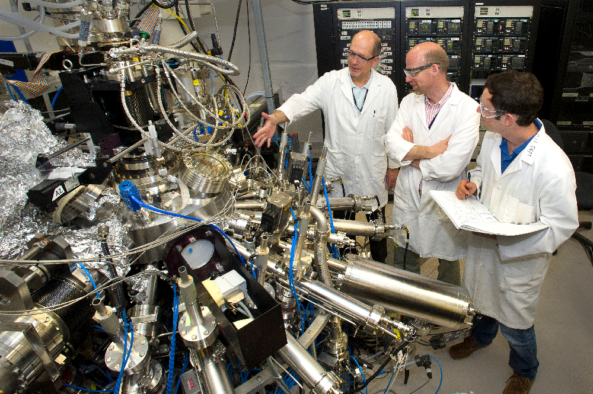
Why
Well, that shouldn’t be that hard

Slide 7

Why
That’s the trend

Slide 8

Why
Everyone’s done it already

Slide 9

Why
We've got grant from our boss

Slide 10
What we wanted to check out

Slide 11
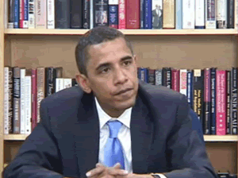
What we wanted to check out
How to start

Slide 12
What we wanted to check out
Versioning

Slide 13

What we wanted to check out
Mythical scaling

Slide 14

What we wanted to check out
What to do when service is down

Slide 15

What we wanted to check out
How to find a service

Slide 16

What are microservices all about

Slide 17
What are microservices all about
(…) the microservice architectural style is an approach to developing a single application as a suite of small services, each running in its own process and communicating with lightweight mechanisms (…) - martin fowler

Slide 18
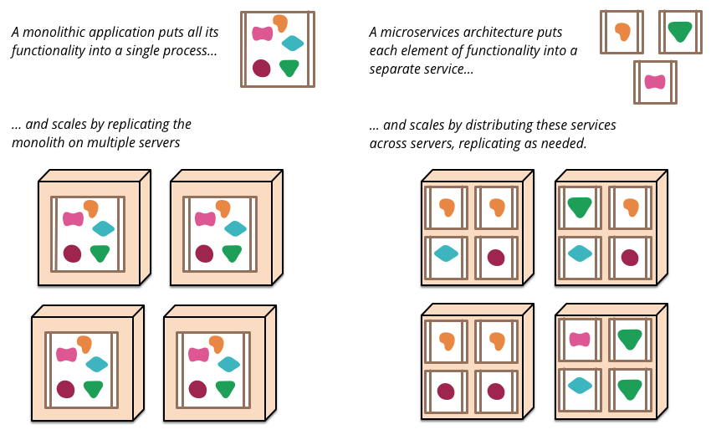
What are microservices all about
http://martinfowler.com/articles/microservices.html

Slide 19

What are microservices all about
Decentralized Governance

Slide 20

What are microservices all about
Design for failure

Slide 21

What are microservices all about
Evolutionary Design

Slide 22

Stuff we’ve done

Slide 23

Stuff we’ve done
It works (mostly)

Slide 24
Stuff we’ve done
We have scaling, but without a slider

Slide 25
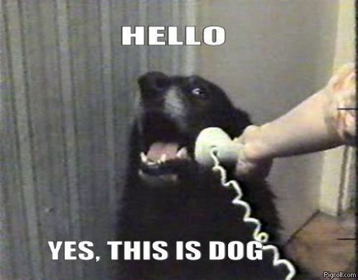
Stuff we’ve done
Services register automatically

Slide 26
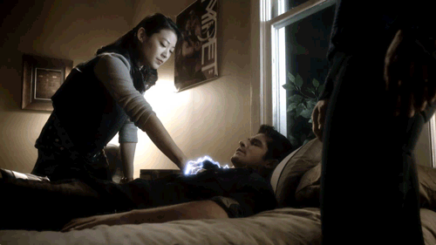
Stuff we’ve done
Services can die and can be restored

Slide 27

Problems we’ve faced

Slide 28
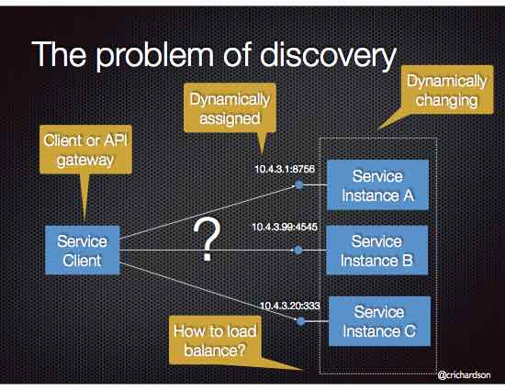
What are microservices all about

Slide 29
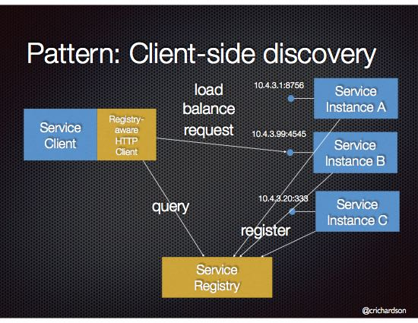
What are microservices all about

Slide 30
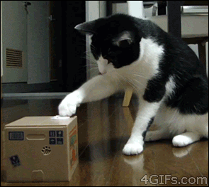
Problems we faced
New ASP.NET

Slide 31
Problems we faced
Managing lifecycle of services

Slide 32
Problems we faced
Dependencies between services

Slide 33

Problems we faced
Configuration management

Slide 34

Stuff we’ve learnt

Slide 35
Stuff we’ve learnt
Use frameworks!
Consul
Zookeeper
Eureka
etcd

Slide 36
Stuff we’ve learnt
Automatic deploy
Notes:
Continuous delivery
Automatyczne testy
Deploy na produkcje
Manualne testy na produkcji

Slide 37
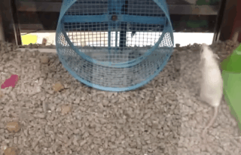
Stuff we’ve learnt
Don’t try to reinvent the wheel

Slide 38
Stuff we’ve learnt
Frameworks do a lot for you. Sometimes you don’t even know that you have to have something

Slide 39
Stuff we’ve learnt
Reusable code!

Slide 40

Stuff we’ve learnt
Log!

Slide 41
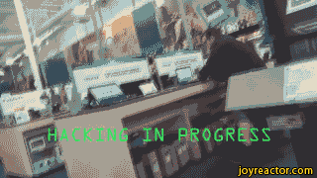
Demo
Demo, party hard, crash bytes!

Slide 42
Stuff we’ve learnt
Micro services are not the silver bullet

Slide 43
Questions?

Slide 44
Feedback: jaroslaw.stadnicki@gmail.com https://bitbucket.org/jstadnicki/calculator-uservice

Slide 45
Thank you

Slide 46
PGS Software S.A.
Tel.: +48 71 79 82 692 Fax: +48 71 79 82 690 E-mail: pgs-soft@pgs-soft.com
www.pgs-soft.com

